Slide 1
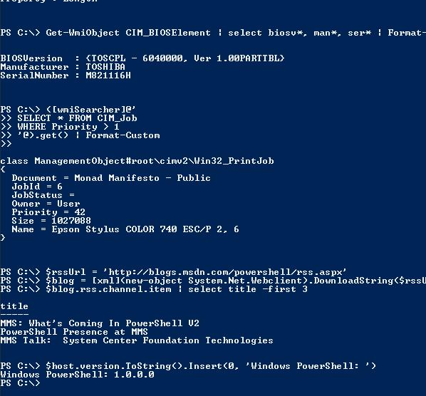
Rest APIs
Get more PowerShell I/O with
Thijs de Meester
OGD ICT-Diensten
info@tdemeester.nl
@thijsdemeester
Notes:
Questions just ask

Slide 2
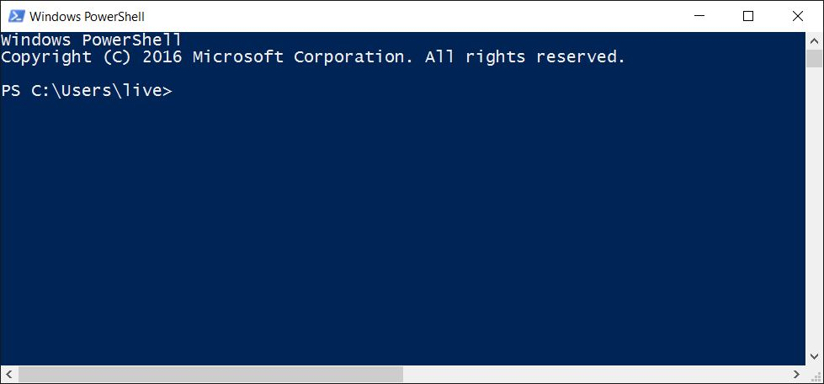
Powershell and data

Slide 3
Powershell and data
LOCAL SYSTEM
- System modules

Slide 4
Powershell and data
LOCAL SYSTEM
System Modules
REMOTE SYSTEM
‘External’ Modules

Slide 5















Powershell and data
LOCAL SYSTEM
- System modules
REMOTE SYSTEM
‘External’ Modules

Slide 6
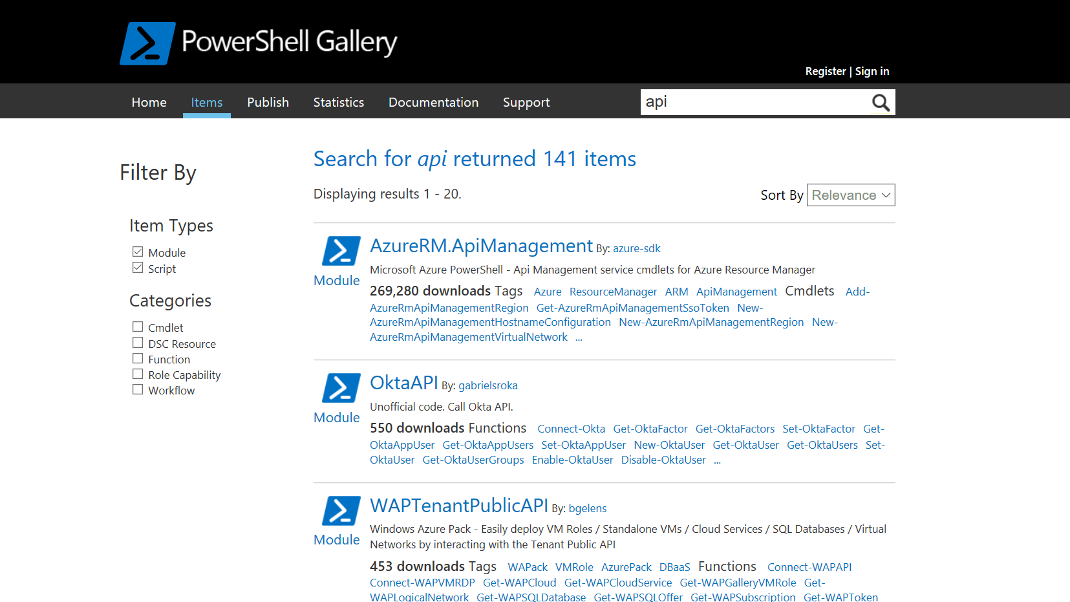

Slide 7
Powershell and data
LOCAL SYSTEM
- System modules
REMOTE SYSTEM
‘External’ Modules
WEB SYSTEM
Community Modules:
Github
Twitter
AWS
Gitlab
Slack
Graph API

Slide 8
Powershell and data
LOCAL SYSTEM
- System modules
REMOTE SYSTEM
‘External’ Modules
WEB SYSTEM
Community Modules:
Github
Twitter
AWS
Gitlab
Slack
Graph API

Slide 9
RESTFul Web Services
Notes:
First of:
Challenge

Slide 10
RESTFul Web Services
Architectural style
Implementations use standards:
HTTP-based
Notes:
Architectural style not a protocol.
Defines result not method.
Unlike SOAP:
Not an ‘official’ standard

Slide 11
RESTFul Web Services
Architectural style
Implementations use standards
HTTP-based
Notes:
Architectural style not a protocol.
Defines result not method.
Unlike SOAP:
Not an ‘official’ standard

Slide 12
RESTFul Web Services
Architectural style
Implementations use standards
HTTP-based

Slide 13
RESTful communication
Authentication
Request
Parse Result
Construct Request

Slide 14
RESTful communication
Authentication
Request
Parse Result
Construct Request

Slide 15
RESTful communication
Authentication
Request
Parse Result
Construct Request

Slide 16
RESTful communication
Authentication
Request
Parse Result
Construct Request

Slide 17
RESTFul Web Services
Demo:
Construct request
Run Request
Parse Result
Notes:
Consider talking about:
Cmdlets
Pipeline
Scripting
Hosting

Slide 18
HTTP Request URL
<uri>?<parameters>
https://www.cleverbot.com/getreply?key=x
Parameters
<name>=<value>
Notes:
Hexadecimal characters

Slide 19
HTTP Request Methods
Get (Get)
Put (Set)
Post (New)
Delete (Remove)

Slide 20
RESTFul Web Services
Demo:
Passing parameters
Collections and elements

Slide 21
RESTful communication
Authentication
Request
Parse Result
Construct Request

Slide 22
RESTful communication
Authentication
Request
Parse Result
Construct Request

Slide 23
RESTFul Authenticatio
None
Key
Basic
Oauth (fancy key)

Slide 24
Sources
Oauth Example
https://blog.kloud.com.au/2016/09/13/leveraging-the-microsoft-graph-api-with-powershell-and-oauth-2-0/
Cleverbot docs
https://www.cleverbot.com/api/howto/
BreweryDB docs
http://www.brewerydb.com/developers/docs

